Slide 1
Parallel Computing in MATLAB

Slide 2
Practical application of parallel computing
Why parallel computing?
Need faster insight to bring competitive products to market quickly
Computing infrastructure is broadly available (multicore desktops, GPUs, clusters)
Why parallel computing with MATLAB
Leverage computational power of more hardware
Accelerate workflows with minimal to no code changes to your original code
Focus on your engineering and research, not the computation
Notes:
Discuss why Cleve invented MATLAB. Our goal is to do the same for parallel computing.
Example: tic, for aa = 1:10, pause(.5), end, toc
tic, parfor aa=1:10, pause(.5), end, toc
web(fullfile(docroot, 'distcomp/functionlist.html'))
http://www.mathworks.com/help/releases/R2016a/distcomp/functionlist.html
What’s the need for Parallel Computing you might ask or what’s the motivation for it ?
The size of the problems we need to solve is increasing and there’s a growing need to gain faster helping bring products to market quickly. And this need exists for engineers and researchers across multiple Industries and Applications !
Another motivation is simply the fact that hardware is becoming powerful- Modern computers, even laptops, are parallel in architecture with multiple processors/cores. Access to GPUs, cluster of computers or even cloud computing infrastructure is becoming common.
However the challenge lies in the fact that you need software to utilize the power of this hardware and hence parallel computing expertise is a requirement
How do MathWorks Parallel Computing Tools help ?
Enables Engineers, scientists and researchers like yourself leverage the computational power of available hardware without the need to be a parallel computing expert
Accelerate your workflows with minimal changes to your existing code
Allow you to seamlessly scale your applications and models from your Desktop to clusters in your organization or on the cloud if you need access to more computational power/memory
Let’s look at some examples of customer across multiple industries who have been using MathWorks parallel computing tools and why they chose parallel computing

Slide 3
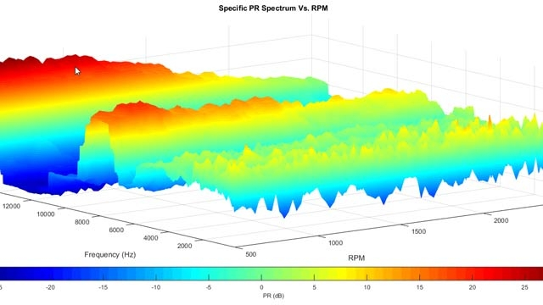

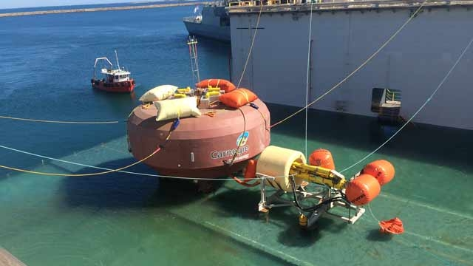


Automotive Test Analysis and Visualization
3-4 months of development time saved
Heart Transplant Studies
4 weeks reduced to 5 days
6X speedup in process time
Discrete-Event Model of Fleet Performance
Simulation time reduced from months to hours
20X faster simulation time
Linkage with Deep Learning Toolbox
Design and Build Wave Energy Farm
Sensitivity studies accelerated 12x
Calculating Derived Market Data
Implementation time reduced by months
Updates loaded 8X faster
Notes:
Here are some examples of where people are successfully using our parallel computing tools. All of these people are scaling up their problems to run on additional hardware and seeing significant benefits from it.
Here are examples from some of our user stories of what can be done with our parallel computing tools. In many of these cases, they wrote the code once and could run in it many different environments. Some of these are simple Monte Carlo analyses, some are parameter sweeps, there are also people doing optimization.
Our parallel computing tools are all about enabling you to scale to more hardware without needing to be an expert in parallel computing.

Slide 4
Agenda
Getting started with parallel computing in MATLAB
Scaling beyond the desktop to clouds and clusters
Big Data
Accelerate applications with NVIDIA GPUs
Summary

Slide 5
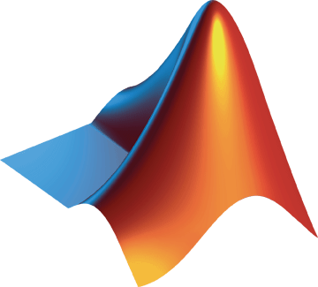
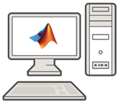

Parallel Computing Paradigm Multicore Desktops
Core 1
Core 2
Core 3
Core 4
Parallel Computing Toolbox
Notes:
MathWorks offers two parallel computing tools. The first is Parallel Computing Toolbox which is our desktop solution that allows users to be more productive with their multicore processors by utilizing headless MATLAB sessions called workers to use the full potential of their hardware and speed up their workflow. The Toolbox provides easy to use syntax that allows users to stay in their familiar desktop environment while our solution takes care of the details of using multiple sessions in the background. We make the tough aspects of parallelism easy for users: GPU, Deep Learning, Big Data, Clusters, Clouds
Parallel ComputingToolbox also provides support for NVIDIA CUDA-based GPUs, and provides the syntax used by our second tool, MATLAB Parallel Server.
Under the hood the parallel computing products divide the tasks/computations/simulations and assigns them to these workers in the background – enabling the computations to execute in parallel.
A key concept for parallel computing with MATLAB is the ability to run multiple MATLAB computational engines that are controlled by a single MATLAB session and that are licensed as workers. A collection of these workers with inter-process communication is what we call a parallel pool.
The parallel computing products provide features that can divide tasks/computations/simulations and assigns them to MATLAB computational engines in the background – enabling execution in parallel.
In general you should not run more MATLAB computational engines than the number of physical cores available. Otherwise, you are likely to have resource contention.
Note that Parallel Computing Toolbox provides licensing for enough workers to cover all of the physical cores in a single machine.
See also: https://www.mathworks.com/discovery/matlab-multicore.html

Slide 6
Accelerating MATLAB and Simulink Applications
 | Parallel-enabled toolboxes
 | Simple programming constructs
 | Advanced programming constructs
Ease of Use
Greater Control
Notes:
At its simplest is the built-in support that we have in many toolboxes for parallel computing, such as optimization. In these toolboxes, all you have to do is indicate that you wish to go parallel using the UseParallel flag.
If you want a bit more control, then Parallel Computing Toolbox adds some parallel keywords into the MATLAB language. An example of this is Parfor or Parsim commands.
Finally, if you need lots of control in your program, then we have some advanced programming constructs that will let you do things like send messages between workers.

Slide 7
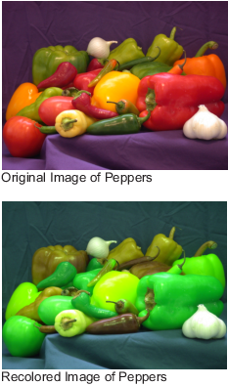
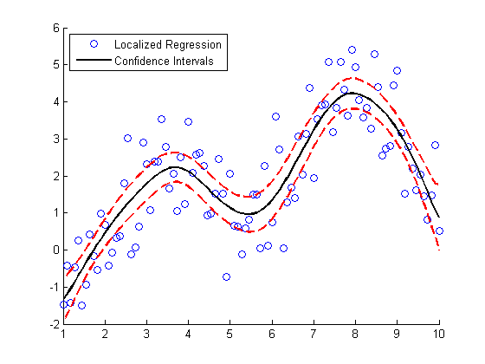
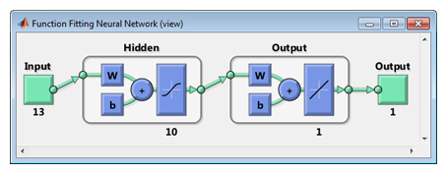
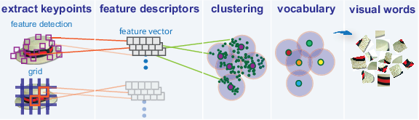
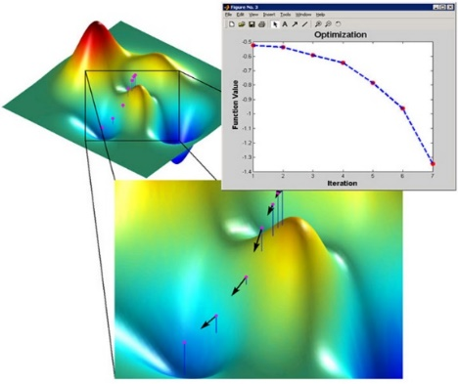
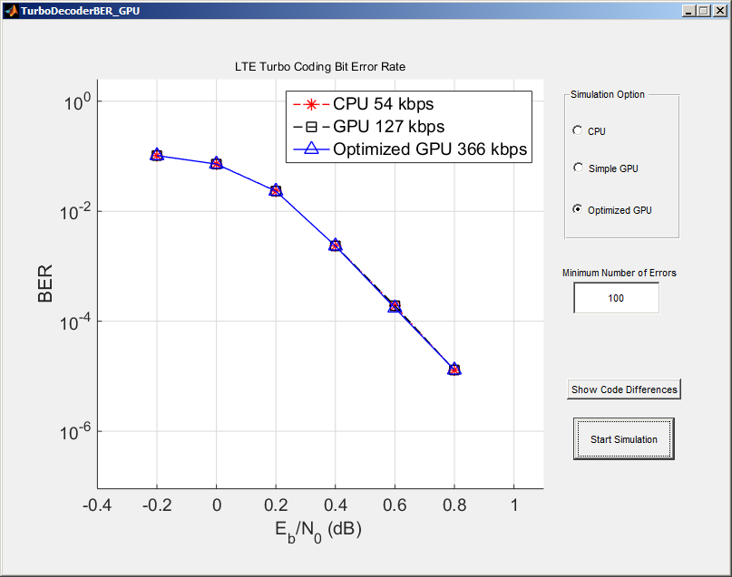
Parallel-enabled Toolboxes (MATLAB® Product Family)
Enable acceleration by setting a flag or preference
Image Processing
Statistics and Machine Learning
Deep Learning
Batch Image Processor, Block Processing, GPU-enabled functions
Resampling Methods, k-Means clustering, GPU-enabled functions
Deep Learning, Neural Network training and simulation
Signal Processing and Communications
Computer Vision
Optimization
GPU-enabled FFT filtering, cross correlation, BER simulations
Bag-of-words workflow
Estimation of gradients
Other Parallel-enabled Toolboxes

Slide 8
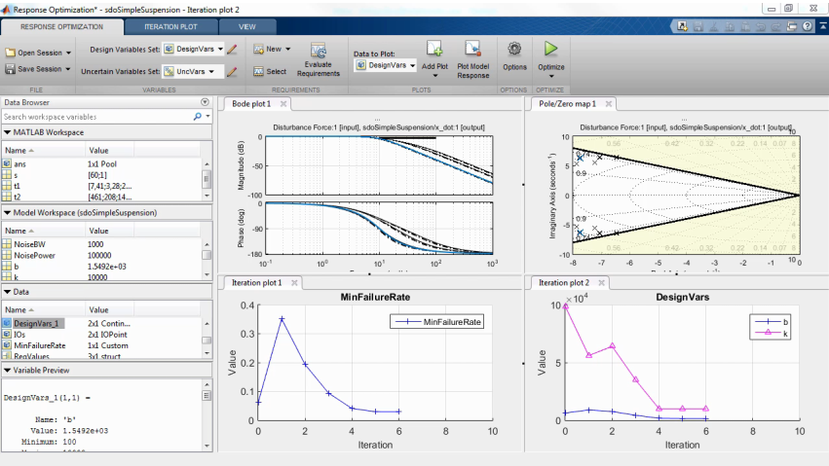
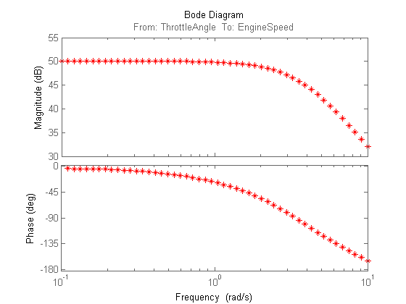
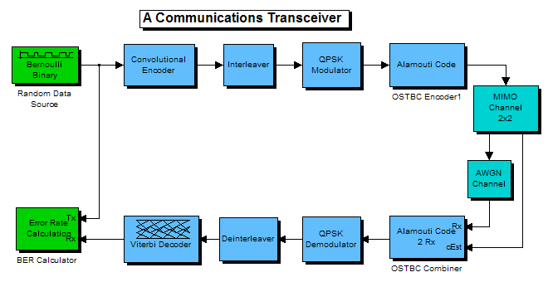
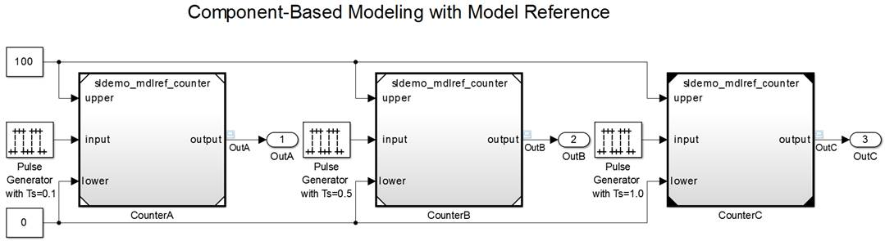
Parallel-enabled Toolboxes (Simulink® Product Family) Enable parallel computing support by setting a flag or preference
Simulink Design Optimization
Simulink Control Design
Response optimization, sensitivity analysis, parameter estimation
Frequency response estimation
Communication Systems Toolbox
Simulink/Embedded Coder
GPU-based System objects for Simulation Acceleration
Generating and building code
Other Parallel-enabled Toolboxes

Slide 9

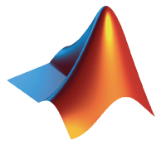
Explicit Parallelism: Independent Tasks or Iterations Simple programming constructs: parfor, parfeval
Examples: parameter sweeps, Monte Carlo simulations
No dependencies or communications between tasks
MATLAB client
MATLAB workers
Time
Time
Notes:
How was we express parallelism in code?
If you are dealing with problems that are computationally intensive and are just taking too long because there are multiple tasks/iterations/simulations you need to execute to gain deeper insight → these are ideal problems for parallel computing and the easiest way to address these challenges is to use parallel for loops.
Real-world examples of such problems are parameter sweeps or Monte Carlo simulations.
For example, lets say you have 5 tasks to be completed - If you run these in a FOR loop, they run serially one after the other – u wait for one to get done, then start the next iteration– However if they’re all independent tasks with no dependencies or communication between individual iterations – you can distribute these tasks to the MATLAB workers we spoke about – multiple tasks can execute simultaneously → you’ll maximize the utilization of the cores on your desktop machine and save up on a lot of time !

Slide 10

Mechanics of parfor Loops
2
4
4
6
6
8
2
8
10
1
3
3
5
5
7
1
7
9
9
10
Worker
a = zeros(10, 1)
parfor i = 1:10
a(i) = i;
end
a
a(i) = i;
Worker
a(i) = i;
Worker
Worker
a(i) = i;
a(i) = i;

Slide 11
Key functionality
 | Description | Functionality | Ease of use | Control
Parallel Enabled Toolboxes | Ready to use parallelized functions in MathWorks tools | MATLAB and Simulink parallel enabled functions Toolbox integration | Turnkey-automatic | Minimal (presets)
Common programming constructs | Constructs that enable you to easily parallelize your code | parfor gpuArray batch distributed/tall parsim parfeval | Simple | Some
Advanced programming constructs | Advanced parallelization techniques | spmd arrayfun/pagefun CUDAKernel MapReduce MATLAB Spark API | Advanced | Extensive

Slide 12
Agenda
Getting started with parallel computing in MATLAB
Scaling beyond the desktop to clouds and clusters
Big Data
Accelerate applications with NVIDIA GPUs
Summary

Slide 13
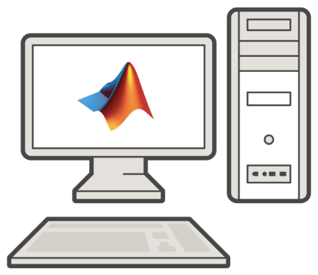



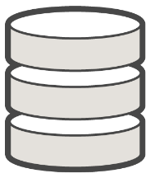
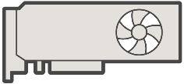
Running MATLAB on a Cluster
Cluster
SSH, VNC, RDP, etc.
Notes:
One simple way to get started with cluster computing is logging onto the cluster and running MATLAB there. This does not have to involve MATLAB Parallel Server and can be done with Parallel Computing Toolbox.

Slide 14
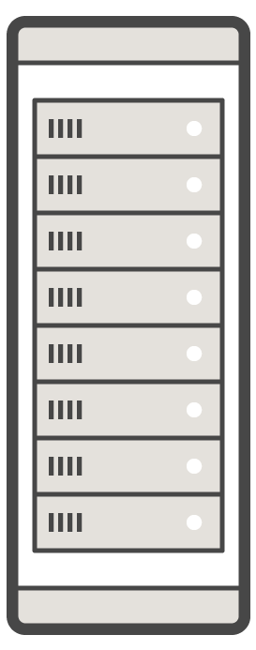



Migrate Execution to a Cluster Environment with MATLAB Parallel Server
GPU
GPU
Multi-core CPU
Multi-core CPU
MATLAB
MATLAB Parallel Server
Parallel Computing Toolbox
Notes:
Alternatively, you can submit jobs to a remote cluster from your laptop or desktop machine. This requires that you have MATLAB and Parallel Computing Toolbox and MATLAB Parallel Server installed and licensed on the cluster end.

Slide 15
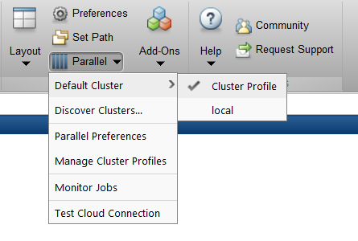
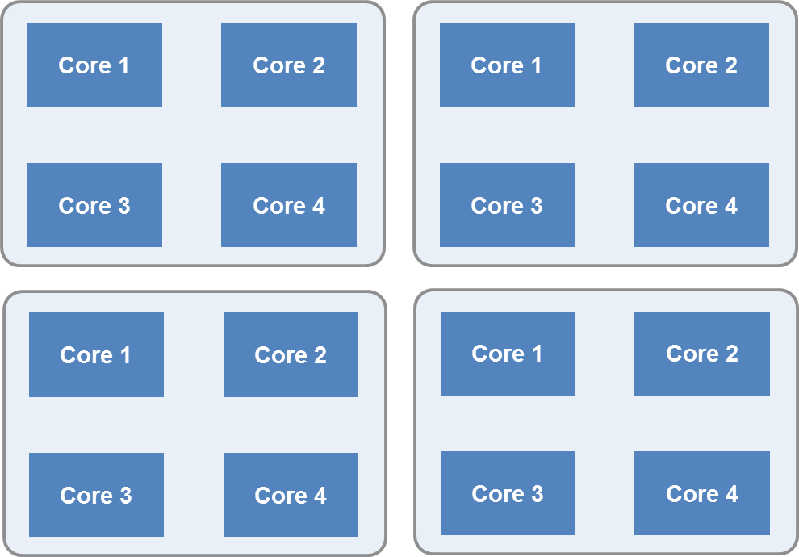
Parallel Computing Paradigm Clusters and Clouds
Cluster
MATLAB Parallel Server
Notes:
The problems or challenges you work on might need additional computational resources or memory than what is available on a single multicore desktop computer
You can also scale up and access additional computational power or memory of multiple computers in a cluster in your organization or on the cloud. When we say scale up it essentially means that your pool or workers are now located on the cluster computers instead of the cores of your desktop computer. Irrespective of where your pool of workers are, your interface remains in the MATLAB Desktop. We’ve separated the algorithm from the infrastructure so you can write your code as you always do.

Slide 16
Take Advantage of Cluster Hardware
Offload computation:
Free up desktop
Access better computers
Scale speed-up:
Use more cores
Go from hours to minutes
Scale memory:
Utilize distributed arrays
Solve larger problems without re-coding algorithms
Notes:
There are a few primary reasons to move your Parallel Computing Toolbox workflow from a Desktop computer to a cluster:
<click>
You might want to perform computations on a cluster to free up your desktop computer for other work. You can submit jobs to a cluster and retrieve the results when they‘re done. You can even shut down your local computer while you wait.
<click>
You can also use a cluster to scale an application that you‘ve developed on your desktop. Getting computations to take minutes rather than hours allows you to make updates to code and execute multiple runs all in the same day.
<click>
If you have an array that is too large for your computer's memory, you can use distributed arrays to store the data across multiple computers, so that each computer contains only a part of the array. A growing number of MATLAB matrix operations and functions have been enhanced to work with distributed arrays using the Parallel Computing Toolbox. These enhanced functions allow you to use your desktop session to operate on the entire distributed array as a single entity. [See the Release Notes for recent releases of Parallel Computing Toolbox for more details regarding which functions have been enhanced]

Slide 17
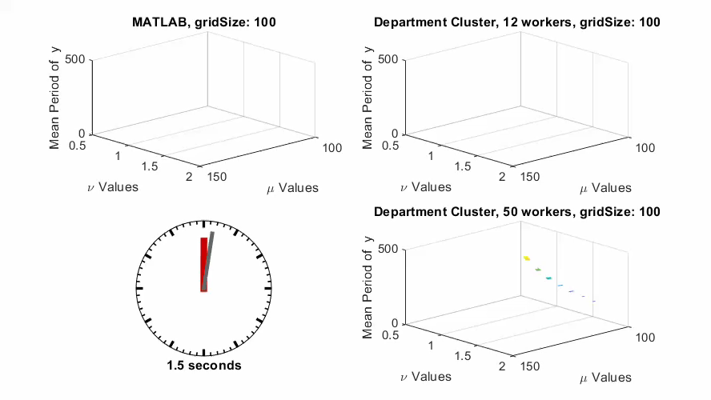
Scaling example: MATLAB, 12 workers, 50 workers
Notes:
In this short movie, you can see the impact of using MATLAB Parallel Server.
In this case, I need to run 100,000 different parameter combinations for a van der Pol Equation parameter sweep. In the elapsed 2 minutes, I can run a small portion of my calculations with desktop MATLAB, I could run about one-quarter of my calculations with 12 workers on a cluster or a high-end desktop, or I could run my entire set of calculations with 50 workers and a cluster with MATLAB Parallel Server.
By adding more resources, I can get more done in less time.

Slide 18
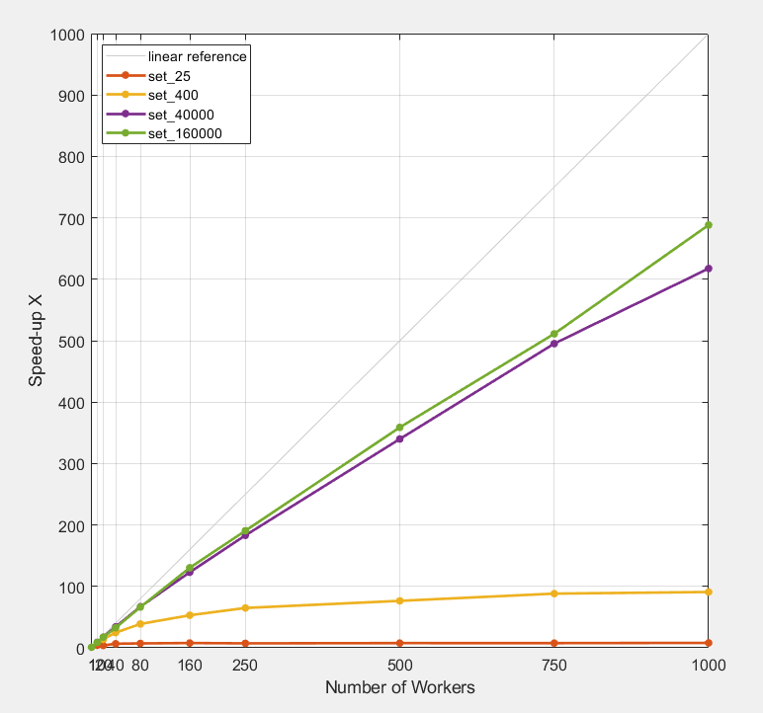
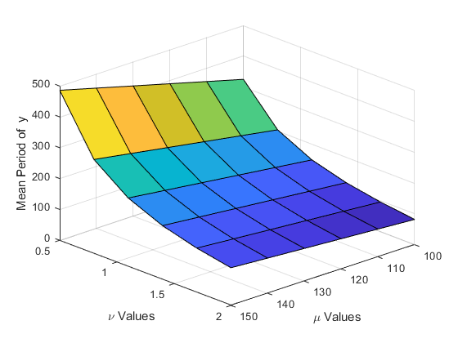
Why parallel computing matters Scaling with a compute cluster
Notes:
In this example, you see a parameter sweep in which we run up to 160,000 different configurations
Doc example https://www.mathworks.com/help/distcomp/examples/plot-progress-during-parallel-computations-using-parfor-and-dataqueue.html?searchHighlight=dataqueue&s_tid=doc_srchtitle
If my problem is well-sized, I can get more than a 90x speed-up with 100 workers.
Just adding more workers is not a guarantee of more speed-up, though. Every application has its limits, and eventually overhead will dominate.
When choosing how many workers you should use, it’s best to think about your overall needs, in this case, even with 64 workers, I can go from 4 hours to just 4 minutes, which might be good enough.
As mentioned previously, the sweet spot is ultimate execution on the order of a few minutes.
Notes:
Computation time is from tic/toc around just the parfor
Ran this on Amazon EC2 (no need to advertise that, but it is true!)
XB=frameworkSubmit(50,200,1,3,'R2014a_c3_192_2hr');
% Add links to blackjack and a\b
% might want to mention partictoc, or pull it from code
% all demos need html version

Slide 19
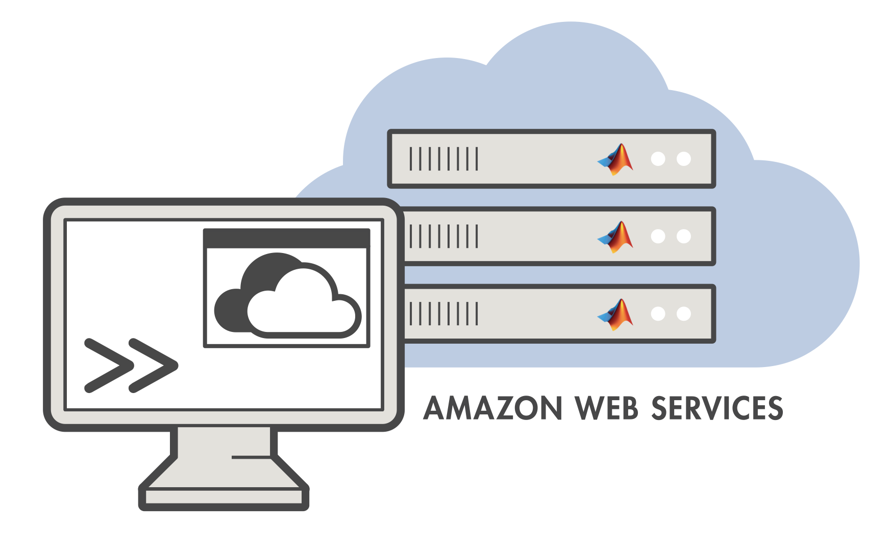
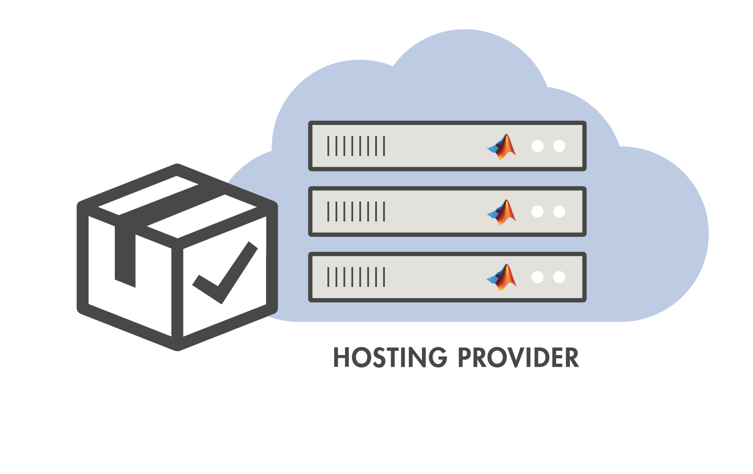
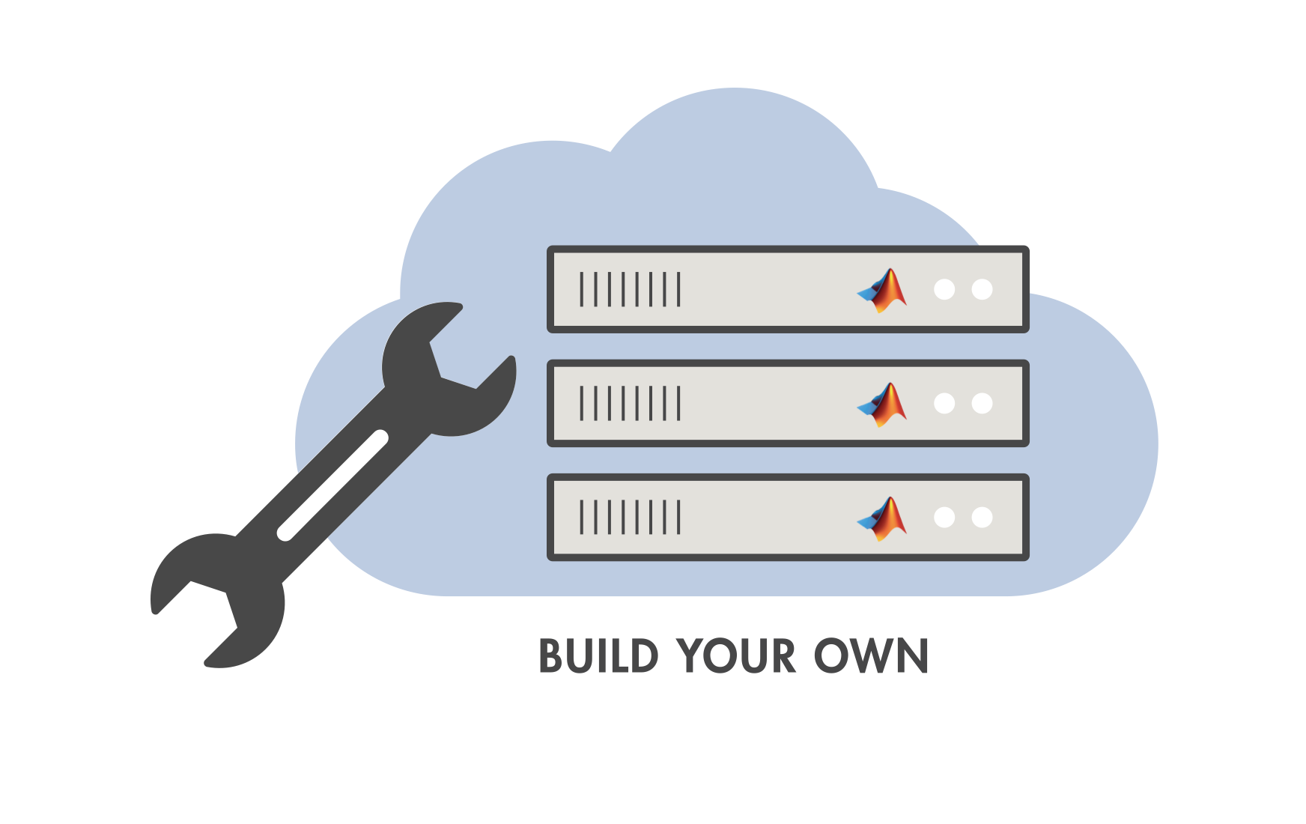
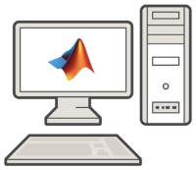

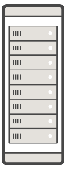

Scale your applications on the desktop and beyond
Option | Parallel Computing Toolbox | MATLAB Parallel Server
 |  | managed by Cloud Center | managed by Hosting Providers | for Custom Cloud Reference Architecture | On Premise
Description | Explicit desktop scaling | Preconfigured clusters in Amazon Web Services | Cloud solutions from MathWorks partners | Custom infrastructure for AWS, Azure, and others | Scale to clusters in your organization
Maximum workers | No limit | 1024 | Defined by Hosting Provider | No limit | No limit
Availability | Worldwide | Worldwide | Worldwide | Worldwide | Worldwide
License Options | Network License Manager LNU | Online Licensing Perpetual, Term * | Network License Manager Online Licensing Perpetual, Term * | Online Licensing Perpetual, Term * | Network License Manager Online Licensing Perpetual, Term *
https://www.mathworks.com/products/matlab-parallel-server/get-started.html
*On-demand available in US and Europe
Notes:
There are multiple options for scaling your MATLAB® programs and Simulink®models beyond the desktop.
Take advantage of your desktop resources using Parallel Computing Toolbox™, and then easily scale your application beyond the desktop to use additional hardware resources without changing your algorithmic code. Our parallel computing tools can support a broad variety of cluster types. We can support ad-hoc cluster made from workstations, traditional clusters, and even the cloud.
Refer to additional information here: http://www.mathworks.com/products/parallel-computing/parallel-computing-on-the-cloud/

Slide 20
Agenda
Getting started with parallel computing in MATLAB
Scaling beyond the desktop to clouds and clusters
Big Data
Accelerate applications with NVIDIA GPUs
Summary

Slide 21
Big solutions
Wouldn’t it be nice if you could:
Easily access data however it is stored
Prototype algorithms quickly using small data sets
Scale up to big data sets running on large clusters
Using the same intuitive MATLAB syntax you are used to

Notes:
So, what’s the real problem when we can’t load the data as usual?
The definition of big data is that normal tools won’t work. That makes processing the data hard, and may require us to switch which tools we use, or at the very least learn new ways of working or new programming techniques for our tool of choice. Many of the BigData capabilities offered by standard tools require recoding algorithms at a much lower level, requiring much more programming expertise.
For some time now we’ve been pondering on these and other questions and trying to work out a neat way to let you take MATLAB code that runs in memory as usual, and without learning new techniques apply those same algorithms to data sets that don’t fit in memory. Even if you do have to change the algorithm a bit, we want it to look like normal MATLAB code that any of you would recognize and understand.

Slide 22
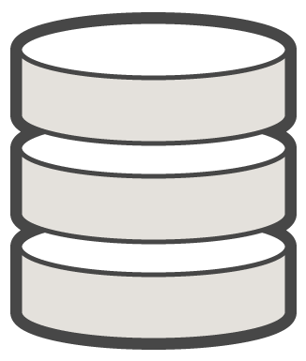


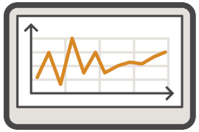


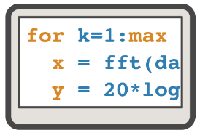
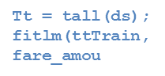


Big Data capabilities in MATLAB
Datastores
Apache Spark™ on Hadoop
11
26
41
15
30
45
20
35
50
12
27
42
16
31
46
21
36
51
13
28
43
17
32
47
22
37
52
Distributed Arrays
Tall
Notes:
MATLAB provides a single, high-performance environment for working with big data. You can:
Access data that does not fit in memory from standard big data sources Use data from a Hadoop Distributed File System (HDFS) in MATLAB
Create repositories of large amounts of images, spreadsheets, and custom files (datastore)
Use capabilities customized for beginners and power users of big data applications Use tall arrays for working with columnar data with millions or billions of rows
Partition data, too big for a single computer, across computers in a cluster using distributed arrays
Use hundreds of MATLAB and toolbox functions supported with tall, distributed, and sparse arrays
Create your own big data algorithms using MATLAB MapReduce or MATLAB API for Spark
Program once, and scale to many execution environments: desktop machines, compute clusters, and Spark clusters

Slide 23
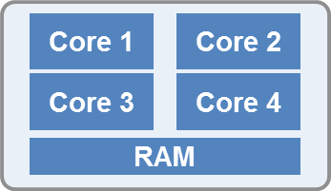
Tall and Distributed Data
Distributed Data
Large matrices using the combined memory of a cluster
Common Actions
Matrix Manipulation
Linear Algebra and Signal Processing
Tall Data
Columnar data that does not fit in memory of a desktop or cluster
Common Actions
Data manipulation, math, statistics
Summary visualizations
Machine learning
Machine
Memory
Notes:
Tall arrays are new in MATLAB release R2016b. However they represent data that doesn’t fit in memory and is backed by files on disk. They are designed to deal with data where you have millions, billions, or more observations of a small number of variables. That means lots of rows and relatively few columns, hence the name “tall”.
As with the other remote array types, they look like ordinary arrays or tables and you can write code in the normal way. However the calculations run quite differently. Out of the box you will be able to use over 200 MATLAB functions from basic operators and math functions, timestamp processing, string manipulation, and including algorithms from the Statistics and Machine Learning Toolbox for classification, regression and other statistical modelling.
Since the pieces are processed independently, you can parallelize this using Parallel Computing Toolbox and process several pieces or chunks of data at a time. The speed-up you will see depends on how many CPU cores you have but should be nearly linear until you hit the I/O limits of your disk or network.
Parallel Computing Toolbox provides something called a “distributed” array. On your desktop this looks just like a normal MATLAB variable but it’s data is distributed across MATLAB workers on the cluster. When you perform an operation on a distributed array the work happens out in the cluster but nothing much else changes from your normal workflow.
You can prototype distributed array on the desktop and then scale up to additional resources with MATLAB Parallel Server.
A large number of standard MATLAB functions work with distributed arrays just as they do for normal variables. That means you can program a distributed-array algorithm just how you would program a normal in-memory algorithm.
Just like we do for the GPU, we have overloaded functions that work transparently with variables that are stored across the memory of multiple physical computers. With the overloaded functions, you can write one application that can work with local data or distributed data without needing to be an expert in message passing. Our goal is to make difficult things easy, so you can focus on your algorithms and research

Slide 24
Agenda
Getting started with parallel computing in MATLAB
Scaling beyond the desktop to clouds and clusters
Big Data
Accelerate applications with NVIDIA GPUs
Summary

Slide 25
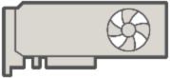

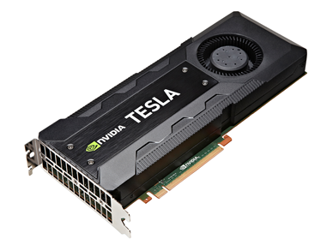
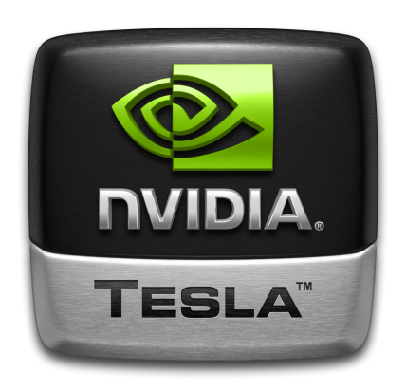
Parallel Computing Paradigm NVIDIA GPUs
GPU cores
Device Memory
MATLAB Desktop
Notes:
Our tools can both be used to speed up your calculation using multiple CPUs and by using GPUs.
Although GPUs have hundreds of cores, we treat the GPU as a single unit, and access directly from a MATLAB computation engine. For example, any single Worker can access the entire GPU.
Expected speed-up varies with problem specifics as well as the avaialable hardware.

Slide 26
Speed-up using NVIDIA GPUs
Ideal Problems
Massively Parallel and/or Vectorized operations
Computationally Intensive
Algorithm consists of supported functions
500+ GPU-enabled MATLAB functions
Additional GPU-enabled Toolboxes
Deep Learning
Image Processing and Computer Vision
Communications
Signal Processing
Statistics and Machine Learning
Transfer Data To GPU From Computer Memory
A=gpuArray(A);
Perform Calculation on GPU
X=exping(A);
Gather Data or Plot
X=gather(X)
GPU cores
Device Memory
MATLAB GPU computing
Notes:
In the case of GPUs, it’s slightly different.
Ideal problems for GPU computing :
1. Massively parallel—The computations can be broken down into hundreds or thousands of independent units of work. You will see the best performance all of the cores are kept busy, exploiting the inherent parallel nature of the GPU.
2. Computationally intensive—The time spent on computation significantly exceeds the time spent on transferring data to and from GPU memory. Because a GPU is attached to the host CPU via the PCI Express bus, the memory access is slower than with a traditional CPU. This means that your overall computational speedup is limited by the amount of data transfer that occurs in your algorithm.
3. Algorithm consists of supported functions
Our developers have written CUDA versions of key MATLAB and toolbox functions and presented them as overloaded functions – We have over 300 GPU-enabled functions in MATLAB and a growing number of GPU-enabled functions in additional toolboxes as well.
The diagram pretty much sums up the easiest way to do GPU computing in MATLAB – Transfer/create data on the GPU using the “gpuArray”, run your function as you would normally - if the inputs are available on the GPU, we do the right thing and run on the GPU and then “gather” the data back to the CPU. This seamless support allows you to run the same code on both the CPU and the GPU.

Slide 27
Agenda
Getting started with parallel computing in MATLAB
Scaling beyond the desktop to clouds and clusters
Big Data
Accelerate applications with NVIDIA GPUs
Summary

Slide 28
Summary
Easily develop parallel MATLAB applications without being a parallel programming expert
Speed up the execution of your MATLAB applications using additional hardware
Develop parallel applications on your desktop and easily scale to a cluster when needed
Notes:
In this presentation, I’ve shown you how easy it can be to use cluster hardware with your MATLAB workflow
I’ve also shown you the specific steps needed. MathWorks provides tools and infrastructure to let you prototype on the desktop, easily start the Amazon resources you need, and extend your workflow to additional hardware.

Slide 29
Valuable Resources
MATLAB Documentation
MATLAB → Advanced Software Development → Performance and Memory
Parallel Computing Toolbox
Parallel and GPU Computing Tutorials
https://www.mathworks.com/videos/series/parallel-and-gpu-computing-tutorials-97719.html
Parallel Computing with MATLAB
https://www.mathworks.com/solutions/parallel-computing.html

Slide 30


MATLAB Central Community
Every month, over 2 million MATLAB & Simulink users visit MATLAB Central to get questions answered, download code and improve programming skills.
Blogs
Answers
Blogs
MATLAB Answers: Q&A forum; most questions get answered in only 60 minutes
MATLAB Answers
File Exchange: Download code from a huge repository of free code including tens of thousands of open source community files
File Exchange
ThingSpeak
Cody: Sharpen programming skills while having fun
Blogs: Get the inside view from Engineers who build and support MATLAB & Simulink
Learn
Contribute
Connect
Cody
and more…
ThingSpeak: Explore IoT Data
And more for you to explore…

Slide 31
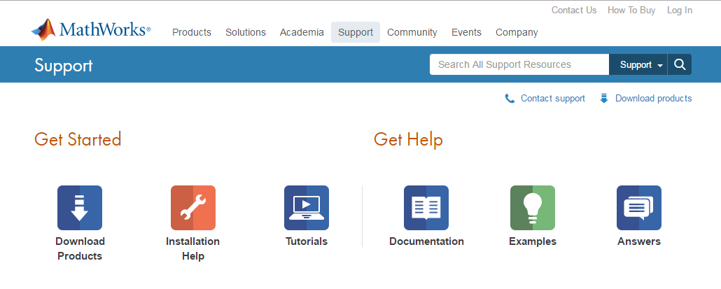

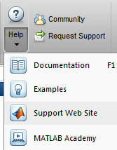
Get Help
Quick access to:
Self-serve tools
Community knowledge base
Support engineers

